Slide 1
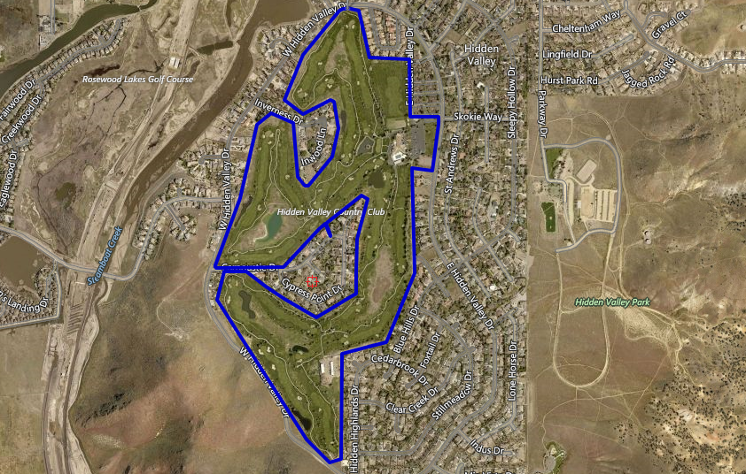
WSUP17-0025 (Verizon Wireless- Hidden Valley Golf Course)
Washoe County Board of Adjustment
February 1, 2018

Slide 2
Overview
Special use permit to construct a new wireless cellular facility consisting of a 70-foot high stealth monopine structure
Located at the Hidden Valley Golf course maintenance yard in the southeast area of golf course
The property is zoned Parks and Recreation (PR)
The allowed height for this location if the tower stealth is 94 feet
The tower is approximately 280 feet from residences

Slide 3
Site Plan
Hidden Valley Golf Course
Maintenance Yard

Slide 4
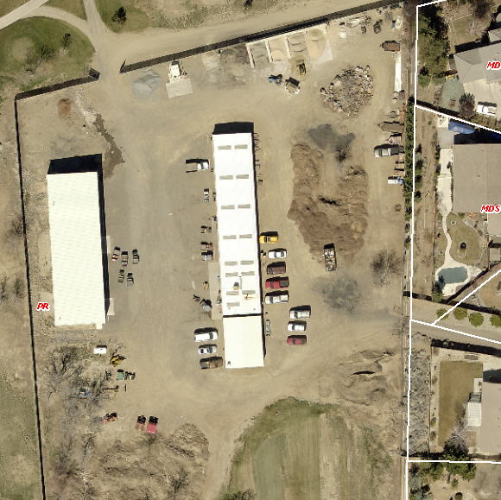
Site Plan
Proposed Tower Location
Location is at unused northwest corner of maintenance yard
A 30’ x 30’ enclosure will be constructed with an 8 foot chain link fence with green privacy slats around the enclosure

Slide 5
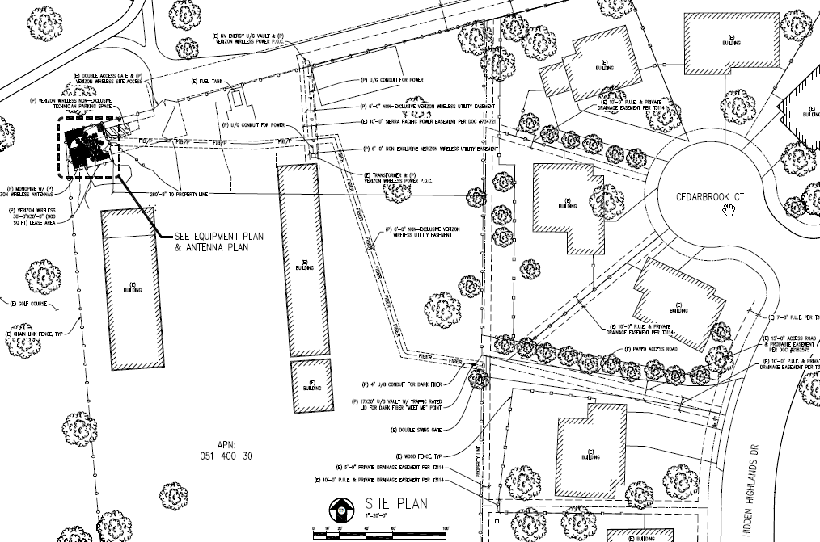
Site Plan
Wireless Enclosure

Slide 6
Site Location

Slide 7
Looking East from the site

Slide 8
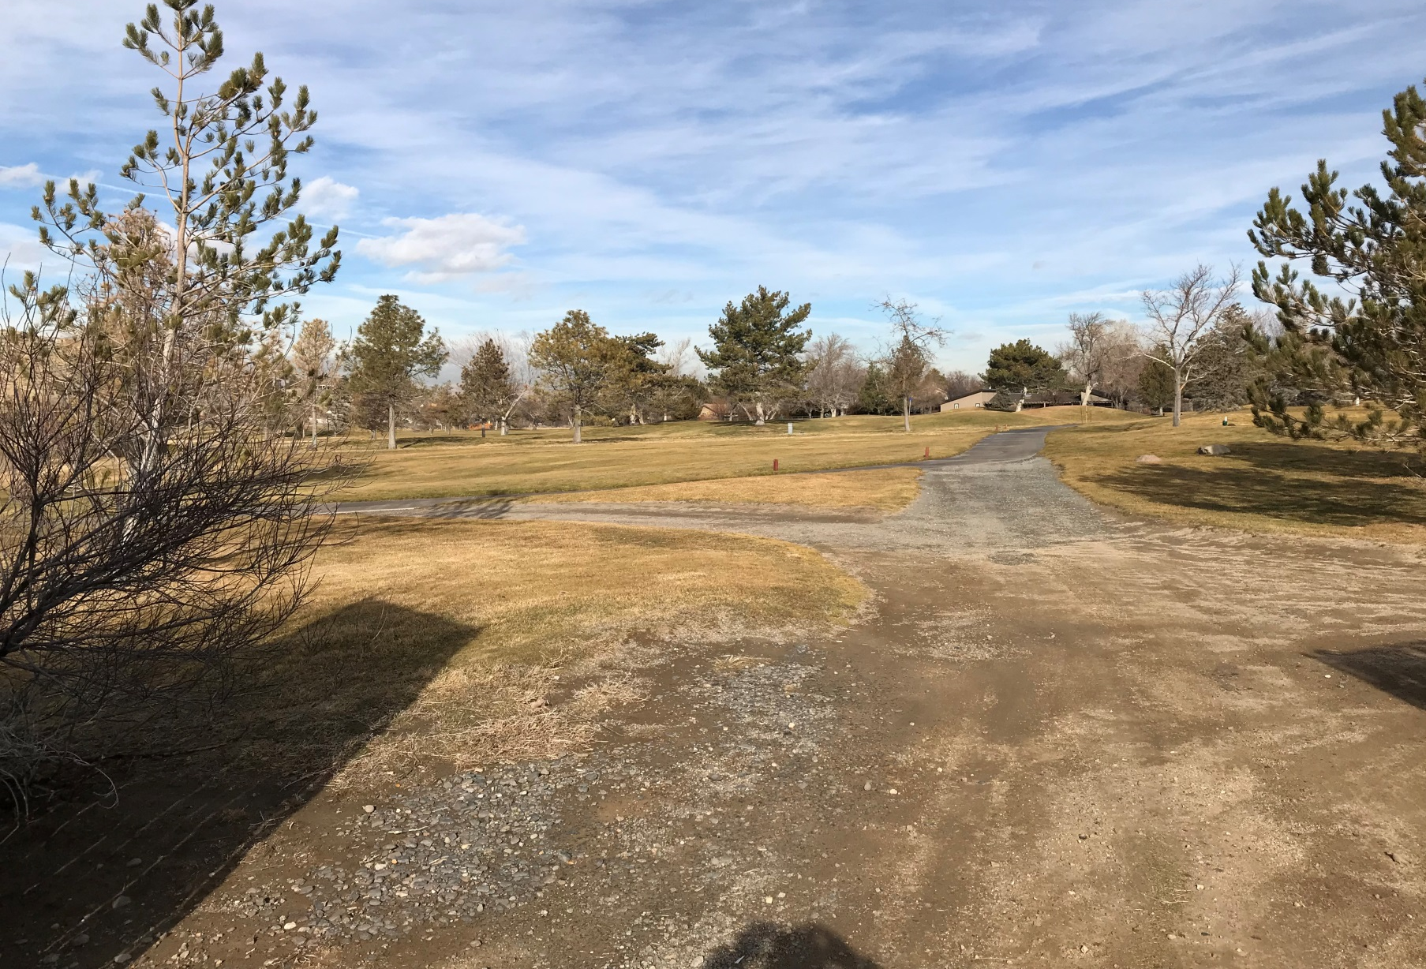
Looking North from the site

Slide 9
Looking South from the site

Slide 10
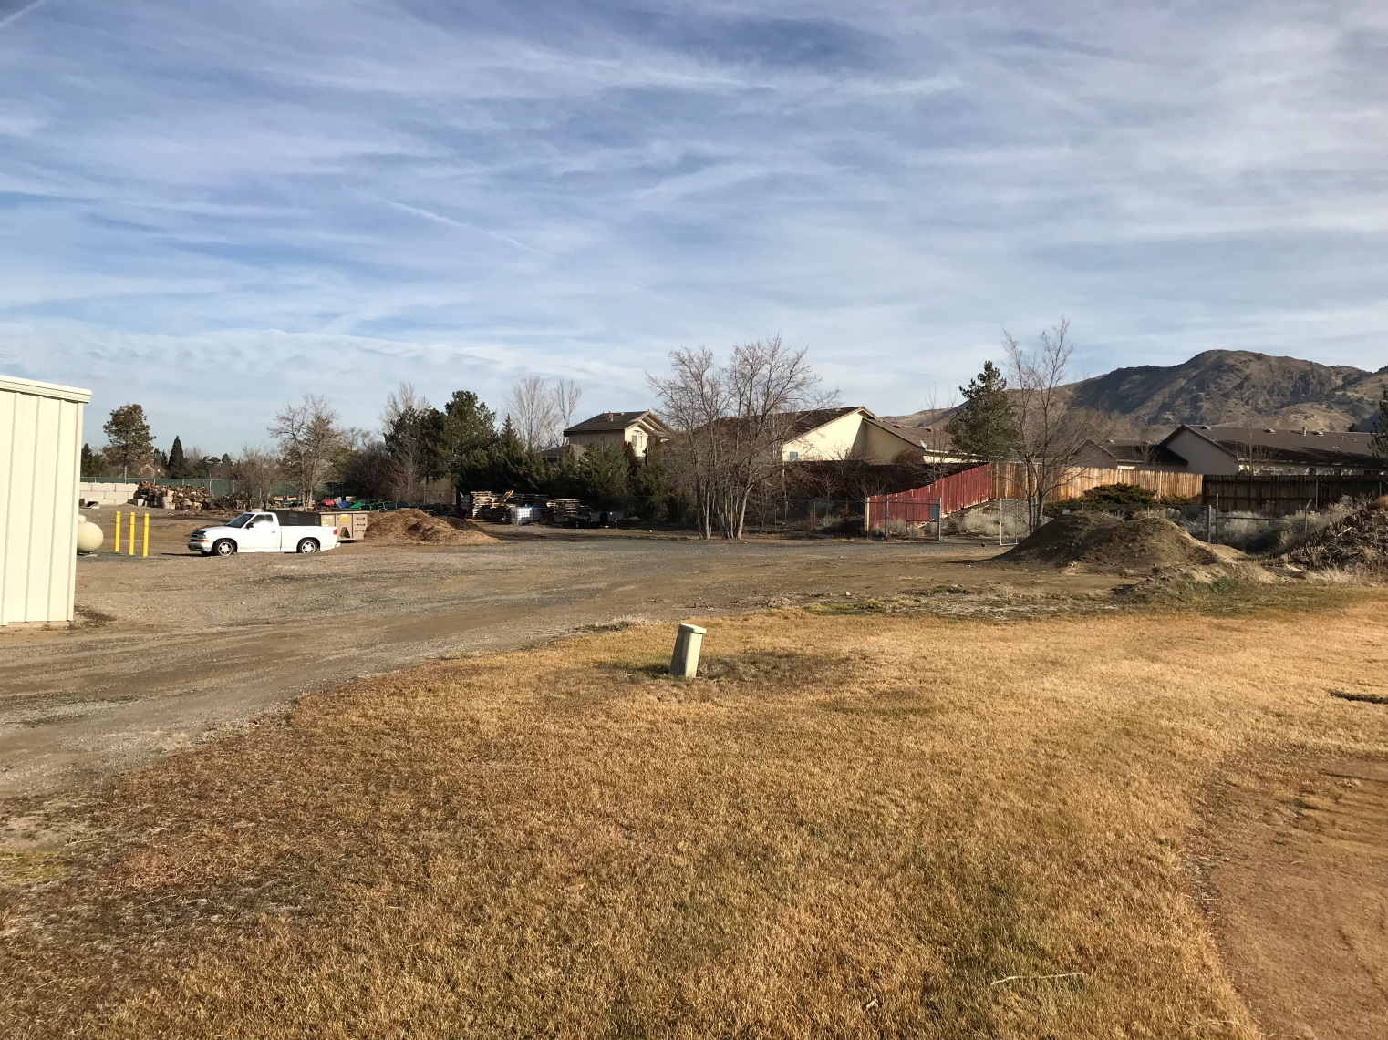
Looking east at backside of Cedarbrook Court

Slide 11
Monopine Structure

Slide 12
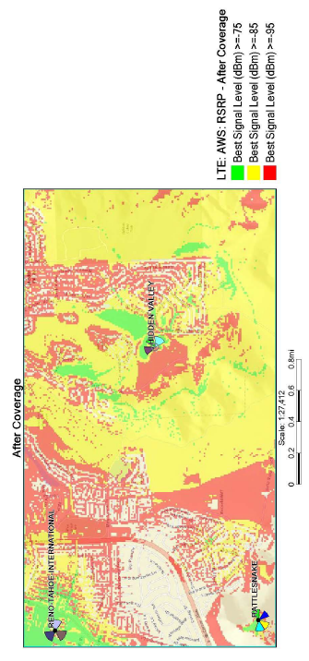
Wireless Coverage
Verizon has coverable and capacity issues in the area
Verizon did look at collocating and other locations
This location met Verizon requirements
The golf course approved the location

Slide 13
Existing & Proposed Views
View looking west

Slide 14
Existing & Proposed Views
View looking northeast

Slide 15
Existing & Proposed Views
View looking southeast

Slide 16
Existing & Proposed Views
View looking northeast

Slide 17
Public Notice & CAB
Parcels within 500 feet were noticed and 426 parcels received notices
I received 3 phone calls with questions about the tower and one letter asking that the tower be located at least ¼ mile away from residences- it’s included in the staff report
The South Meadows Truckee/Washoe Valley CAB met on January 11th
The CAB and public had questions concerning the need for more towers in the area, tower location, tower height, and health issues
The CAB voted to 4 to 1 to recommend approval

Slide 18
Reviewing Agencies
Washoe County Community Service
Planning and Building Division
Engineering and Capital Projects
Washoe County Health District
Air Quality Management Division
Environmental Health Services
Reno-Tahoe Airport Authority

Slide 19
Findings
WCC Section 110.810.30, Special Use Permit Findings:
Consistency with Master Plan
Adequate Improvements
Site Suitability
Issuance Not Detrimental
Effect on Military Installation

Slide 20
Required Findings & Amending Conditions
Staff analysis of required findings is provided in the staff report starting on page 14-15
Staff is able to make all of the required findings and is therefore recommending approval
Amending the conditions, removing Condition F and amending condition J2 (which is now I2, in the amended version) by removing the wording “cross monument/pole” and replacing it with “monopine structure”

Slide 21
Possible Motion
I move that, after giving reasoned consideration to the information contained in the staff report and information received during the public hearing, the Washoe County Board of Adjustment approve with amended conditions Special Use Permit Case Number WSUP17-0025 for Verizon Wireless, having made all five findings in accordance with Washoe County Code Section 110.810.30

